Slide 4
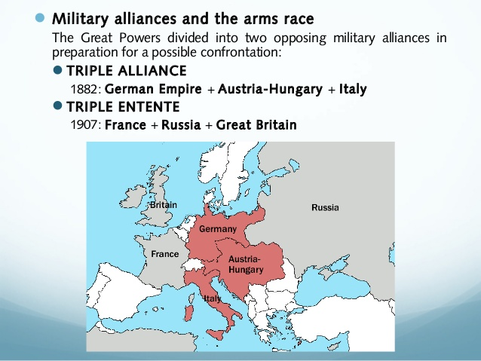

Slide 7
PREPARED BY
Sujatha
SNS Academy

